Slide 1
Controllable Text-to-Image Generation with GPT-4
Tianjun Zhang, Yi Zhang, Vibhav Vineet, Neel Joshi, Xin Wang

Slide 2
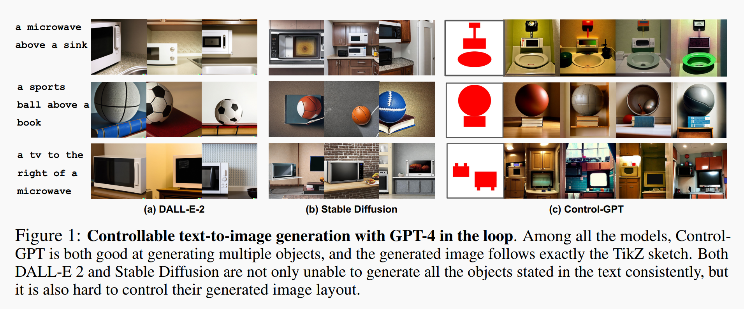
1. What problem does the paper address?
The paper addresses the lack of spatial controllability in state-of-the-art text-to-image models.

Slide 3
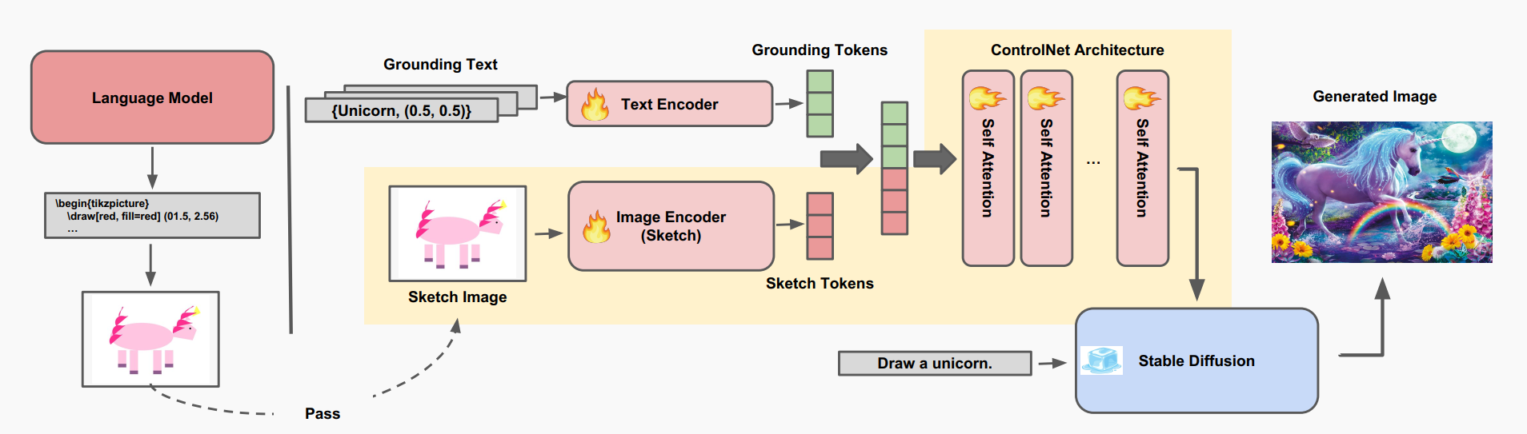
2. proposed method and workflow
The paper proposes Control-GPT, a method that:
Uses GPT-4 to generate TikZ code-based sketches from a text prompt.
Compiles the TikZ code into sketch images and extracts object positions.
Introduces grounding tokens that associate object names with positions to disambiguate sketch semantics.
Uses these as control signals for a ControlNet, which is fine-tuned to understand these sketches and generate realistic images.
Workflow:
Text prompt → GPT-4 → TikZ code.
TikZ code → compiled into a sketch image.
Sketch + text + grounding tokens → fed into ControlNet.
ControlNet → realistic image with correct object layout.

Slide 4
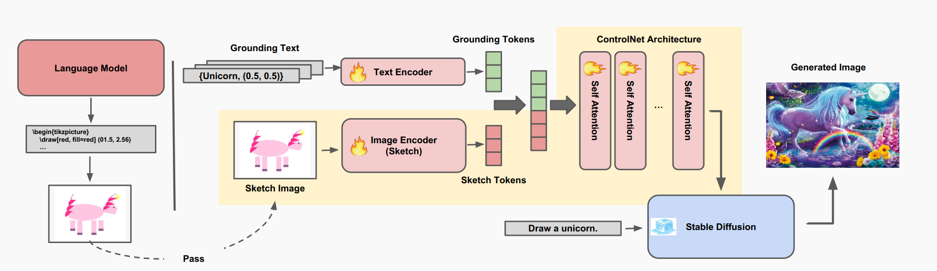
3. modules included
a) GPT-4 sketch generator (zero-shot)
Converts text prompts into TikZ code.
Outputs object names and their bounding box positions.
TikZ is compiled into 2D sketch images.
b) Sketch Encoder (LaTeX)
Converts sketches into visual tokens (image encoder).
Used to provide spatial layout control.
c) Grounding Token Generator (zero-shot)
Extracts object names and positions from GPT-4 output.
Encoded using:
Object name embedding (via Stable Diffusion tokenizer).
Position embedding (via Fourier embedding of object centers).
d) ControlNet (to be finetuned)
A frozen Stable Diffusion backbone.
A trainable control branch added with:
Layers that take sketch tokens and grounding tokens.
Injects these control signals into Stable Diffusion’s latent space via attention and zero convolutions.
Control-GPT Architecture

Slide 5
4. Training
Pretraining:
GPT-4 is in zero-shot mode.
ControlNet is initialized from a pretrained Stable Diffusion model.
Dataset preprocessing:
Use ~120K image-caption-mask triplets from COCO + LVIS.
Convert instance masks to polygon-style sketches (to mimic TikZ).
Generate grounding tokens from object name + box centers.
Finetuning strategy:
Freeze text encoder + Stable Diffusion.
Fine-tune only the control branch.
GPT is not used during finetuning:
Although GPT-4 can synthesize unlimited sketches, it’s hard to find ground-truth images that align with them.

Slide 6
5. inference process
Inputs:
A natural language prompt (e.g., "a sandwich below a TV").
GPT-4 generates:
TikZ sketch code.
Object names and their positions.
Inference pipeline:
Compile TikZ → sketch image.
Encode sketch image + grounding tokens.
Feed into ControlNet (with frozen diffusion model).
Output: Photo-realistic image following the layout described in the prompt.

Slide 7
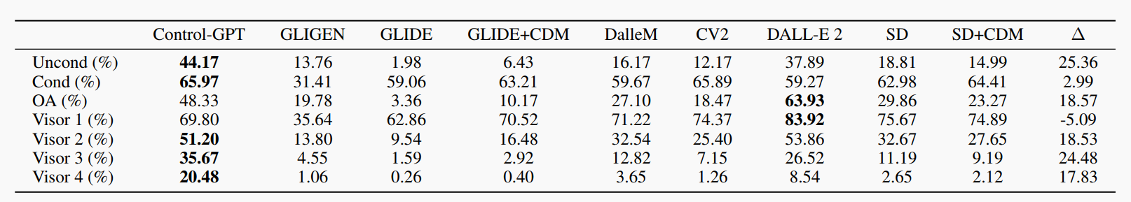
6. evaluation
Dataset :Visor Benchmark
Metrics
Object Accuracy (OA)
Checks if all specified objects (e.g., bird and bus) are present in the image.
Formula: OA = 1 if both objects exist, 0 otherwise.
Unconditional Accuracy (VISOR)
Measures the proportion of images with all objects present and correct spatial relations.
Example: For "a bird to the left of a bus," both bird and bus must exist, and bird must be on the left.
Conditional Accuracy (VISOR_cond)
Probability of correct spatial relations given all objects are present.
Focuses on spatial accuracy when OA = 1.
VISOR_1, VISOR_2, VISOR_3, VISOR_4
VISOR_n: Probability of at least n out of 4 images having correct spatial relations.
VISOR_1: At least 1 image is correct.
VISOR_2: At least 2 images are correct.
VISOR_3: At least 3 images are correct.
VISOR_4: All 4 images are correct.
Results on the Visor spatial dataset

Slide 8
7. summary
the key to the success of this paper
GPT-4's strong code generation (∼97% sketch correctness, which is verified by the authors in their experiments).
Training ControlNet on polygonized sketches to bridge domain gap with TikZ.
Grounding tokens help link abstract sketches to semantic meaning.
Freezing base model and training only the control branch improves training stability and sample efficiency.
Limitations:
Requires datasets with polygon annotations (e.g., LVIS).
GPT-4 dependency for TikZ generation (closed-source, costly).

Slide 9
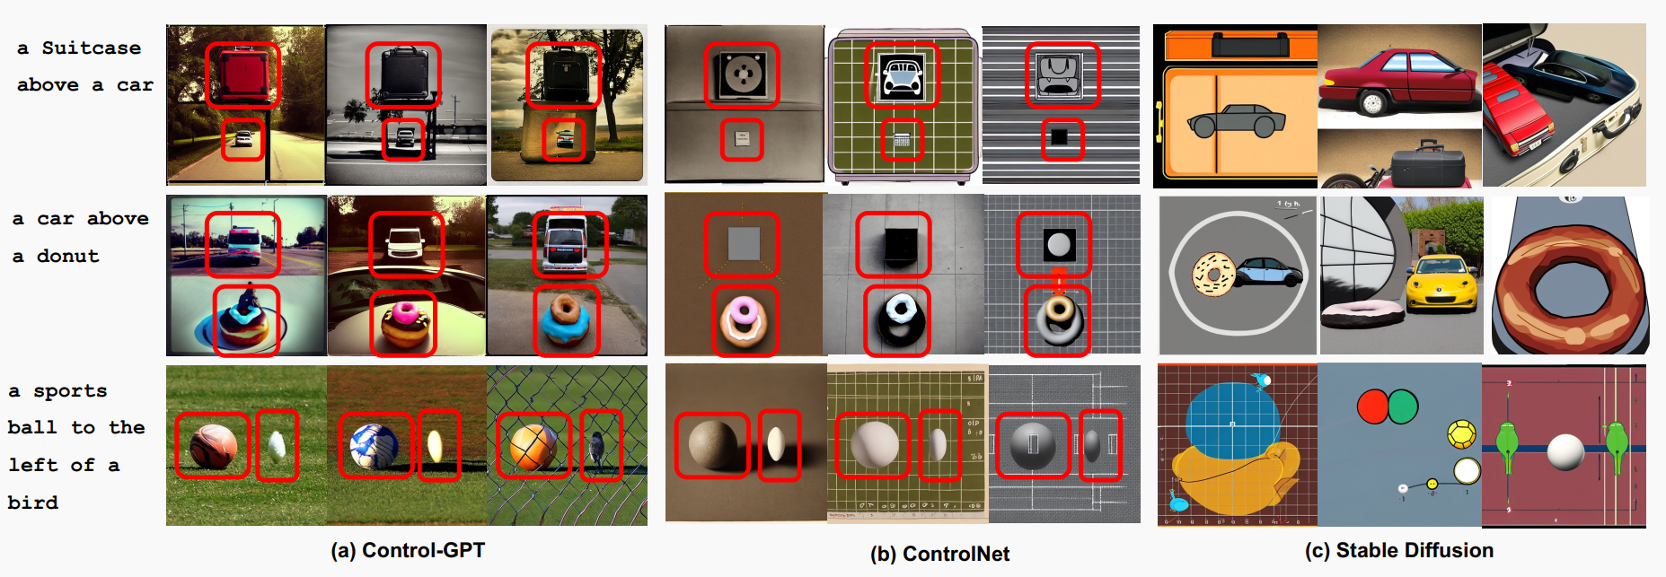
8. More examples

